Slide 1


What is a deleted tweet?
Blog Written by
Ed Summers
https://inkdroid.org/2017/08/18/delete-forensics/
Mohammed Nauman Siddique
Web Archiving Forensics (CS 895)
Spring, 2019
2019-03-06

Slide 2
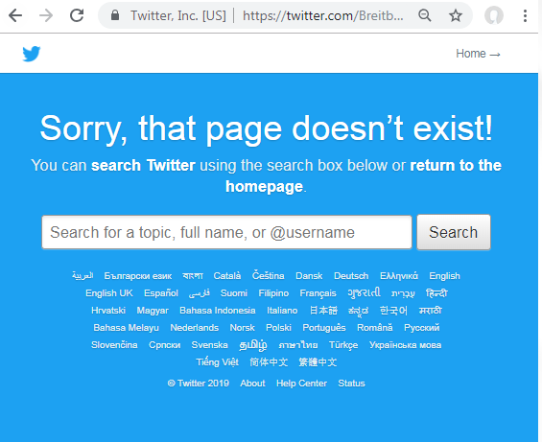
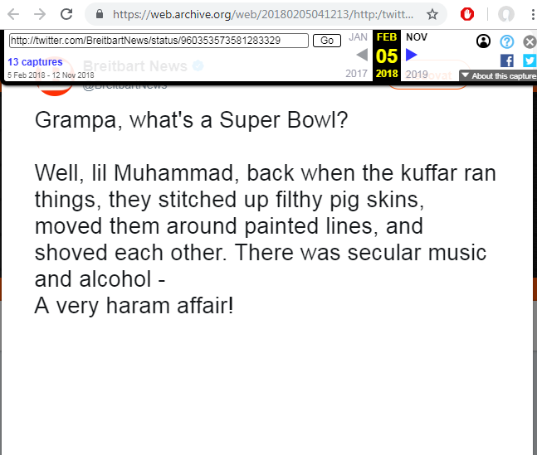
A tweet missing from the live web is referred as a deleted tweet.
Live Version
Archived Version
Source: https://ws-dl.blogspot.com/2018/04/2018-04-23-grampa-whats-deleted-tweet.html

Slide 3
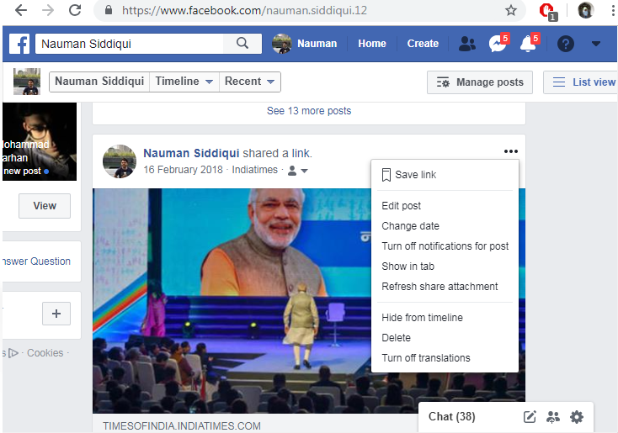
You can edit or delete your post on Facebook

Slide 4
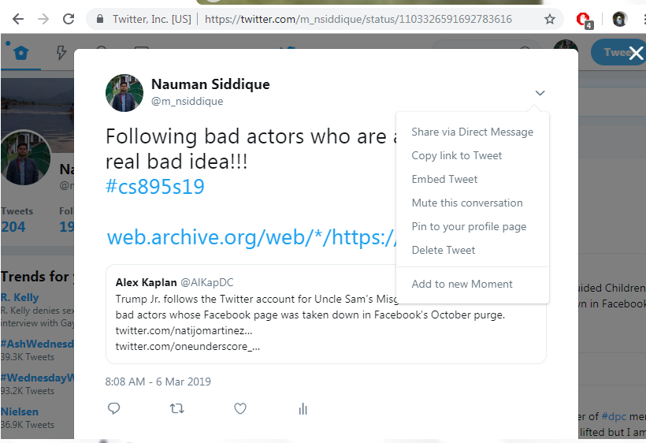
No edit only delete on Twitter

Slide 5
Twitter Account Status
Live
Deleted
Suspended
Protected

Slide 6
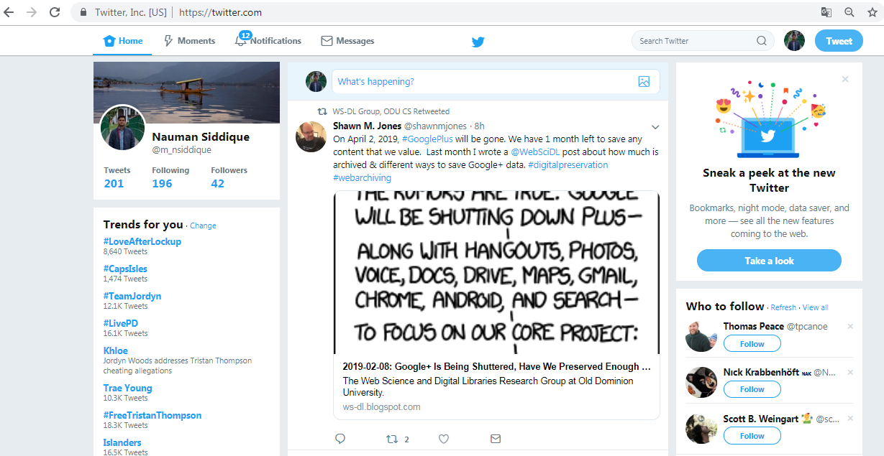
Live Account

Slide 7
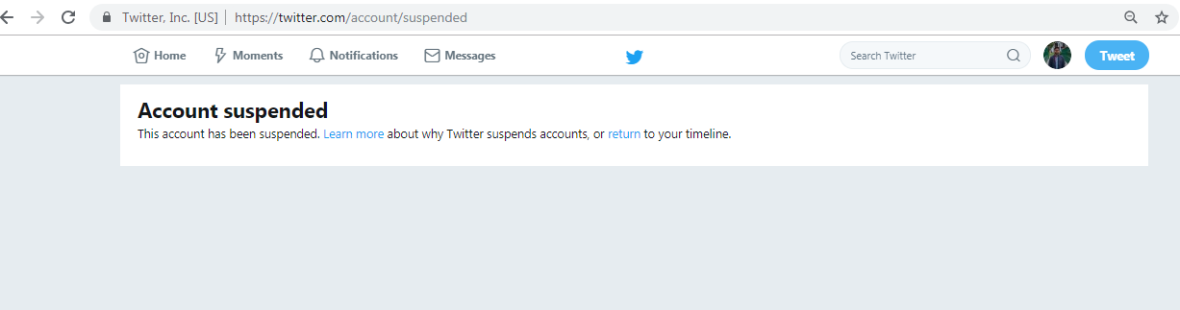
Suspended Account
Source: https://twitter.com/TEN_GOP

Slide 8
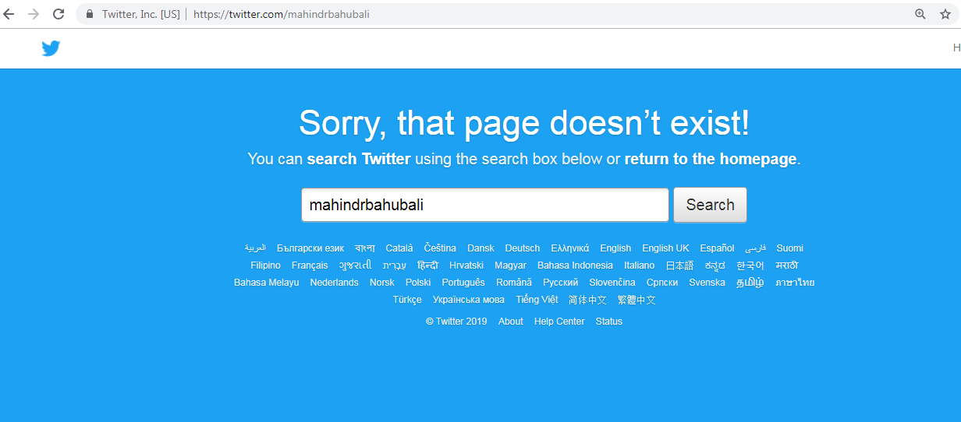
Deleted Account
Source: https://twitter.com/mahindrbahubali

Slide 9
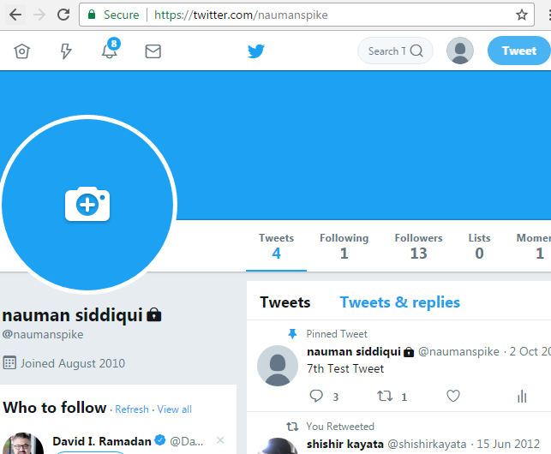
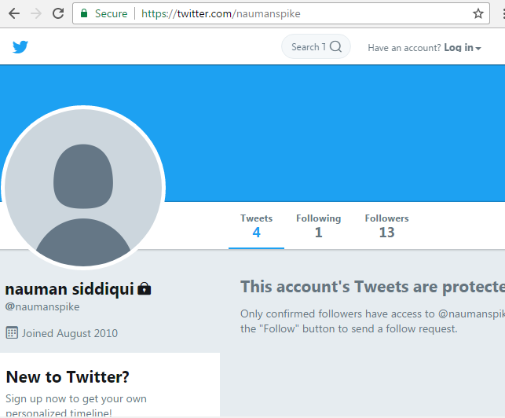
Protected Account
Follower’s view of account
Public view of account

Slide 10
Steps to finding deleted tweets using Twarc
Note: Between step 2 and step 3, we wait hoping for some tweets to be deleted.
Step1: Collected hashtags using Twarc
twarc search '#unitetheright' > tweets.json
Step 2: Extract and sort the tweet identifiers into a file
jq -r '.id_str' tweets.json | sort -n > ids.csv
Step 3: Hydrated tweet ids with twarc. (If the tweet has been deleted then it cannot be hydrated)
twarc hydrate ids.csv > hydrated.json
Step 4: Extract hydrated ids:
jq -r .id_str hydrated.json | sort -n > ids-hydrated.csv
Step 5: Use diff to compare the pre and post hydration ids
diff ids.csv ids-hydrated.csv | perl -ne 'if (/< (\d+)/) {print "$1\n";}' > ids-deleted.csv
Source: https://inkdroid.org/2017/08/15/utr/

Slide 11
Deleted Tweets Classification
TWEET_OK
TWEET_DELETED
USER_DELETED
USER_PROTECTED
USER_SUSPENDED
RETWEET_DELETED
ORIGINAL_TWEET_DELETED
ORIGINAL_USER_SUSPENDED
ORIGINAL_USER_PROTECTED
ORIGINAL_USER_DELETED

Slide 12

TWEET_OK
Tweet is live on the web
Source: https://twitter.com/BreitbartNews/status/960370465465405440

Slide 13
TWEET_DELETED
Source: https://ws-dl.blogspot.com/2018/04/2018-04-23-grampa-whats-deleted-tweet.html

Slide 14
Curl request on deleted tweet
msiddique@sirius:~$ curl -I https://twitter.com/BreitbartNews/status/960353573581283329
HTTP/1.1 404 Not Found
cache-control: no-cache, no-store, must-revalidate, pre-check=0, post-check=0
content-length: 6329
….Deletia….
msiddique@sirius:~$ curl -I https://twitter.com/BreitbartNews
HTTP/1.1 200 OK
cache-control: no-cache, no-store, must-revalidate, pre-check=0, post-check=0
content-length: 458559
…Deletia…

Slide 15
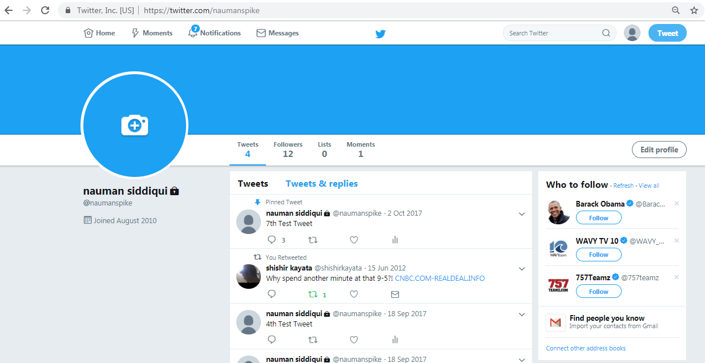
USER_PROTECTED

Slide 16
Curl on protected account
msiddique@atria:~$ curl -IL https://twitter.com/naumanspike/status/914874522859446273
HTTP/1.1 302 Found
cache-control: no-cache, no-store, must-revalidate, pre-check=0, post-check=0
content-length: 121
location: https://twitter.com/naumanspike?protected_redirect=true
…Deletia…
HTTP/1.1 200 OK
content-length: 314326
content-type: text/html;charset=utf-8
…Deletia…

Slide 17
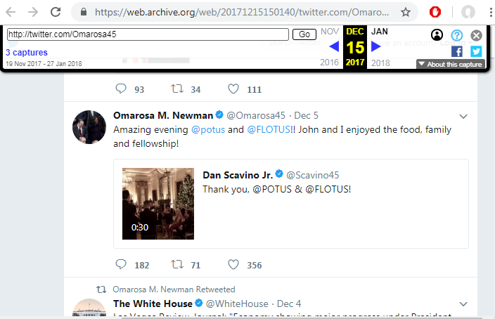
USER_DELETED
Source: https://web.archive.org/web/20171215150140/twitter.com/Omarosa45

Slide 18
Curl request on deleted user
msiddique@sirius:~$ curl -I https://twitter.com/Omarosa45/status/938103241094680576
HTTP/1.1 404 Not Found
cache-control: no-cache, no-store, must-revalidate, pre-check=0, post-check=0
content-length: 6329
….Deletia….
msiddique@sirius:~$ curl -I https://twitter.com/Omarosa45
HTTP/1.1 404 Not Found
cache-control: no-cache, no-store, must-revalidate, pre-check=0, post-check=0
content-length: 6329
…Deletia…

Slide 19
USER_SUSPENDED
Source: https://twitter.com/TEN_GOP/status/764182947083628544

Slide 20
Curl request on suspended account tweet
msiddique@sirius:~$ curl -I https://twitter.com/TEN_GOP/status/764182947083628544
HTTP/1.1 302 Found
cache-control: no-cache, no-store, must-revalidate, pre-check=0, post-check=0
content-length: 103
content-type: text/html;charset=utf-8
date: Sat, 02 Mar 2019 05:45:25 GMT
expires: Tue, 31 Mar 1981 05:00:00 GMT
last-modified: Sat, 02 Mar 2019 05:45:25 GMT
location: https://twitter.com/account/suspended
….Deletia…
HTTP/1.1 200 OK
content-length: 282424
content-type: text/html;charset=utf-8
…Deletia…

Slide 21
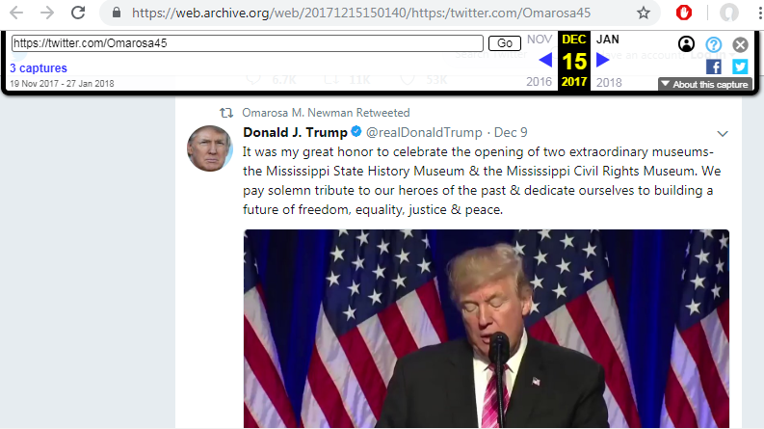
Memento of retweet from @Omarosa45
Source: https://web.archive.org/web/20171215150140/https:/twitter.com/Omarosa45

Slide 22

Original Tweet from @realDonaldTrump
Source: https://twitter.com/realDonaldTrump/status/939560154269405184

Slide 23
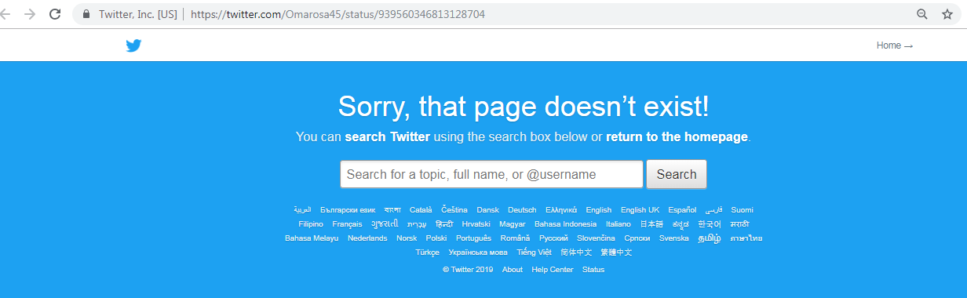
RETWEET_DELETED
Source: https://twitter.com/Omarosa45/status/939560346813128704

Slide 24
Curl request on missing retweet
msiddique@sirius:~$ curl -I https://twitter.com/realDonaldTrump/status/939560154269405184
HTTP/1.1 200 OK
cache-control: no-cache, no-store, must-revalidate, pre-check=0, post-check=0
content-length: 400306
...Deletia…
msiddique@sirius:~$ curl -I https://twitter.com/Omarosa45/status/939560346813128704
HTTP/1.1 404 Not Found
cache-control: no-cache, no-store, must-revalidate, pre-check=0, post-check=0
content-length: 6329
…Deletia…

Slide 25
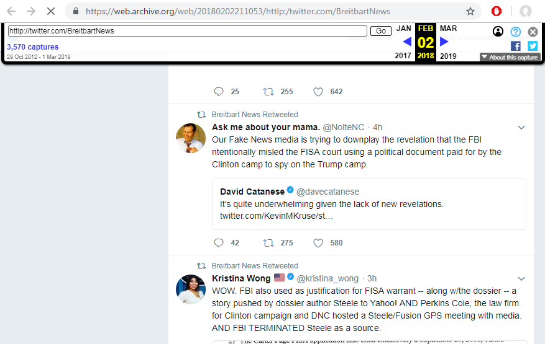
Retweet from Breitbart News
Source: https://web.archive.org/web/20180202211053/https:/twitter.com/BreitbartNews

Slide 26
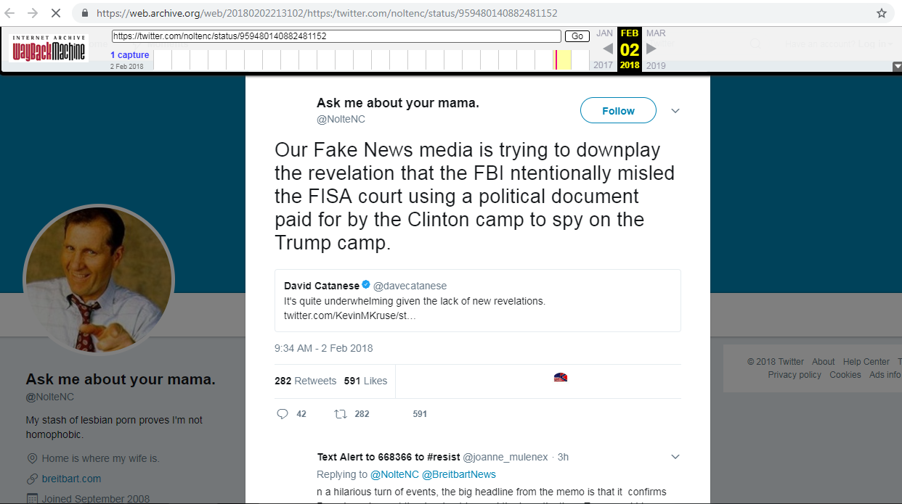
ORIGINAL_TWEET_DELETED
Source: https://web.archive.org/web/20180202213102/https:/twitter.com/noltenc/status/959480140882481152

Slide 27
Curl for original tweet deleted
msiddique@atria:~$ curl -I https://twitter.com/noltenc/status/959480140882481152
HTTP/1.1 404 Not Found
cache-control: no-cache, no-store, must-revalidate, pre-check=0, post-check=0
content-length: 6329
…Deletia…
msiddique@atria:~$ curl -I https://twitter.com/BreitbartNews/status/959483472413896704
HTTP/1.1 404 Not Found
cache-control: no-cache, no-store, must-revalidate, pre-check=0, post-check=0
content-length: 6329
….Deletia….

Slide 28
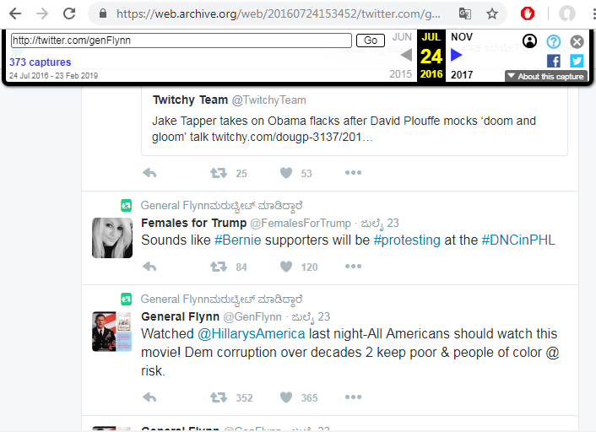
ORIGINAL_USER_SUSPENDED
Source: https://web.archive.org/web/20160724153452/twitter.com/genFlynn

Slide 29
Curl on original user suspended
msiddique@sirius:~$ curl -I https://twitter.com/FemalesForTrump/status/756858127618670593
HTTP/1.1 302 Found
location: https://twitter.com/account/suspended
….Deletia….
HTTP/1.1 200 OK
content-length: 282425
…Deletia…
msiddique@sirius:~$ curl -I https://twitter.com/genFlynn/status/756931867266260992
HTTP/1.1 302 Found
location: https://twitter.com/account/suspended
…Deletia…
HTTP/1.1 200 OK
content-length: 282425
…Deletia…

Slide 30
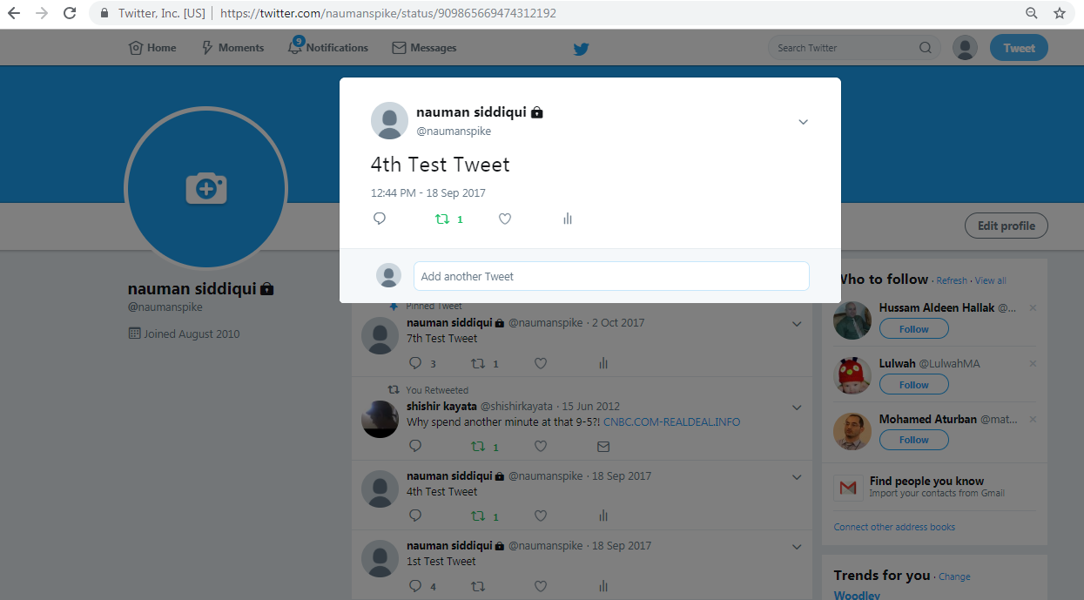
ORIGINAL_USER_PROTECTED (Not possible)
Source: https://twitter.com/naumanspike/status/909865669474312192

Slide 31
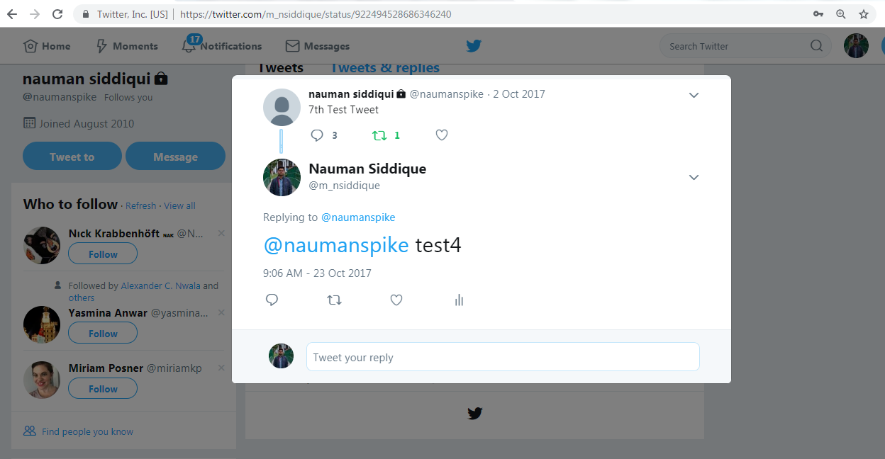
Retweeted possible only when the account was public
Source: https://twitter.com/m_nsiddique/status/922494528686346240

Slide 32
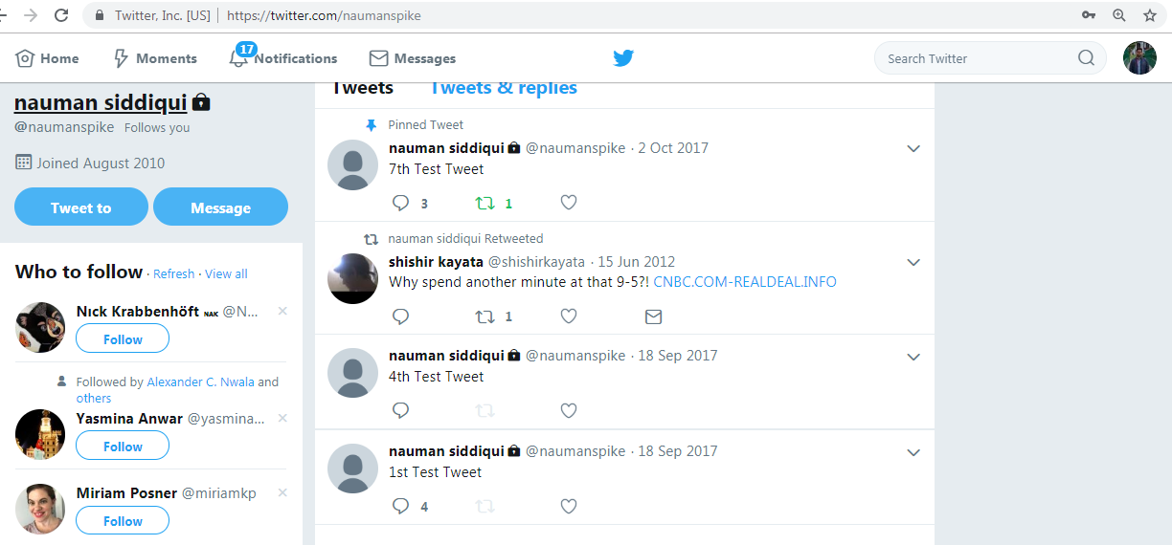
Protected tweets can not be retweeted
Check the retweet button

Slide 33
Curl on protected tweet
msiddique@sirius:~$ curl -I https://twitter.com/naumanspike/status/914874522859446273
HTTP/1.1 302 Found
content-length: 121
location: https://twitter.com/naumanspike?protected_redirect=true
….Deletia….
HTTP/1.1 200 OK
content-length: 314326
…Deletia…
msiddique@sirius:~$ curl -I https://twitter.com/m_nsiddique/status/922494528686346240
HTTP/1.1 200 OK
cache-control: no-cache, no-store, must-revalidate, pre-check=0, post-check=0
content-length: 241224
…Deletia…

Slide 34
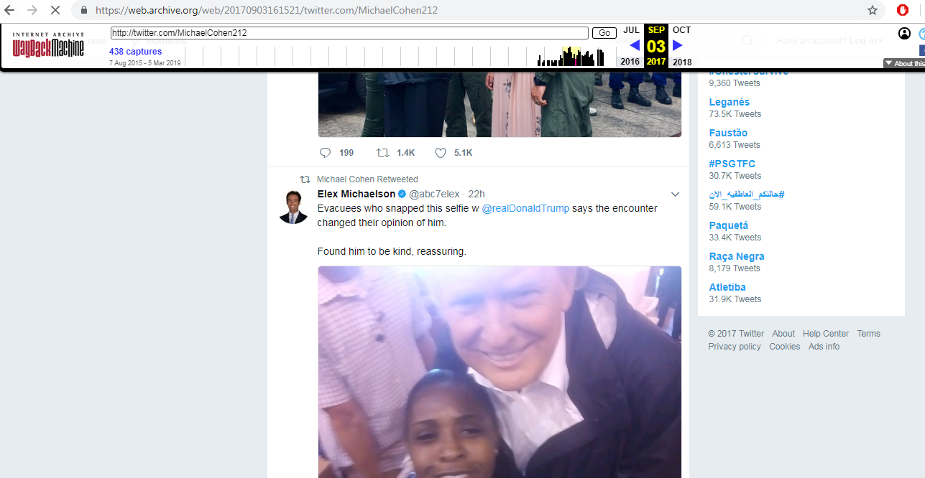
ORIGINAL_USER_DELETED
Source: https://web.archive.org/web/20170903161521/twitter.com/MichaelCohen212

Slide 35
Curl on original user deleted
msiddique@sirius:~$ curl -I https://twitter.com/abc7elex/status/904050245759270912
HTTP/1.1 404 Not Found
cache-control: no-cache, no-store, must-revalidate, pre-check=0, post-check=0
content-length: 6329
….Deletia…
msiddique@sirius:~$ curl -I https://twitter.com//abc7elex
HTTP/1.1 404 Not Found
cache-control: no-cache, no-store, must-revalidate, pre-check=0, post-check=0
content-length: 6329
….Deletia…

Slide 36
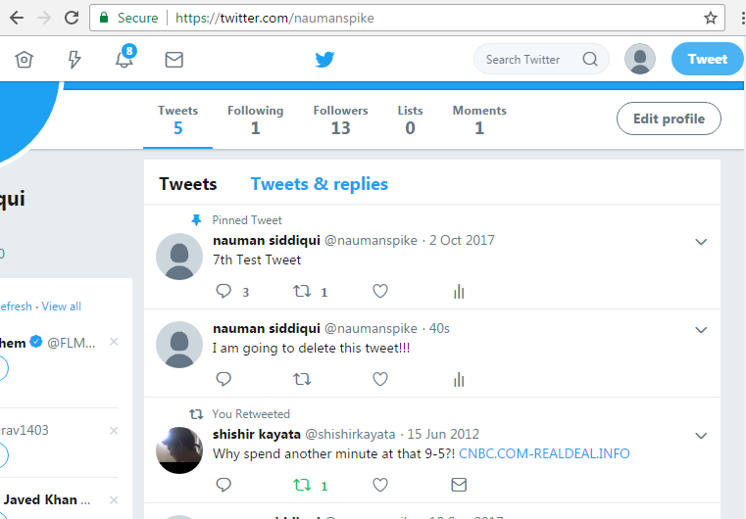
I tweet

Slide 37
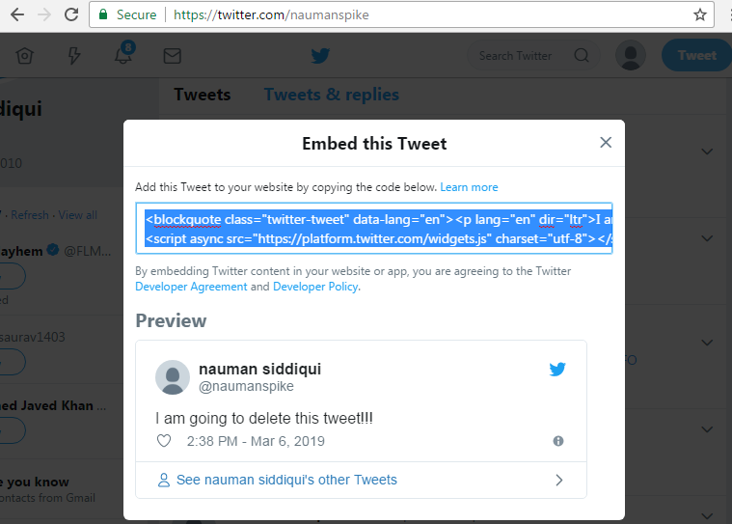
Embed tweet to a webpage

Slide 38
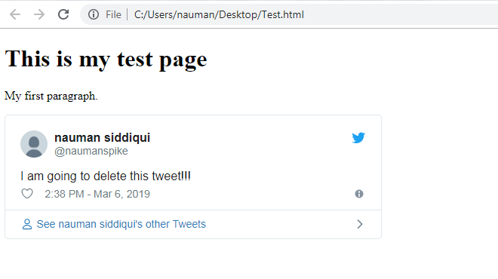
Viewed my tweet on a webpage

Slide 39
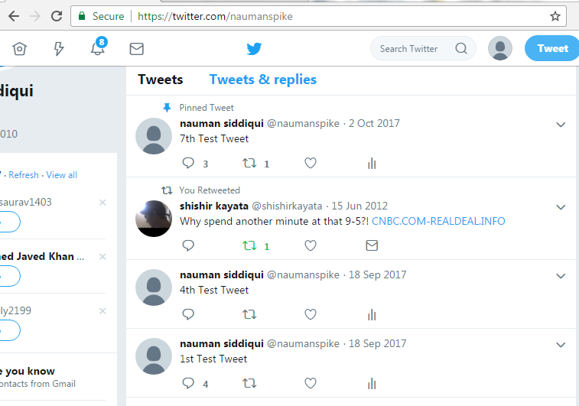
Deleted my tweet

Slide 40
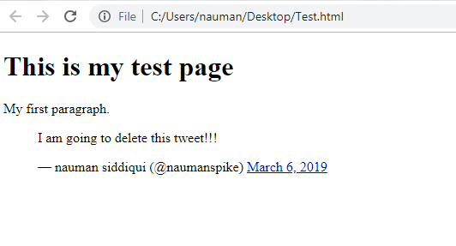
I can still see my deleted tweet

Slide 41
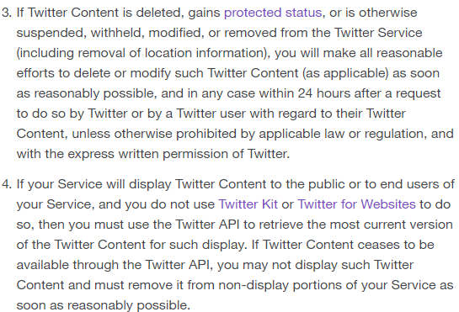
Twitter’s Deleted Tweets Policy
Remove all deleted and protected content with
Cannot display content
not available through
Twitter API
Source: https://developer.twitter.com/en/developer-terms/policy.html

Slide 42
Takeaway
Deleted tweets can occur not only because of the user but also due to the original user who tweeted the tweet.
Tweets returning status code of 404 are deleted.
Tweet returning a redirect status code of 302 can be either a protected tweet or a tweet belonging to a suspended account.
Original tweet returning status code of 200 but the retweet returns a status code of 404 making it a unretweet.

